Slide 1
PL-600 Microsoft Power Platform Architecture Overview

Slide 2
Agenda
Review the key Microsoft Power Platform architecture components
Understand how platform design and limits influence solution architectures
Review how updates and feature releases are rolled out
Understand how to communicate with the customer on how the platform meets their needs
Notes:
We will have deep dive modules on many of the topics like Power Apps and Power Automate

Slide 3




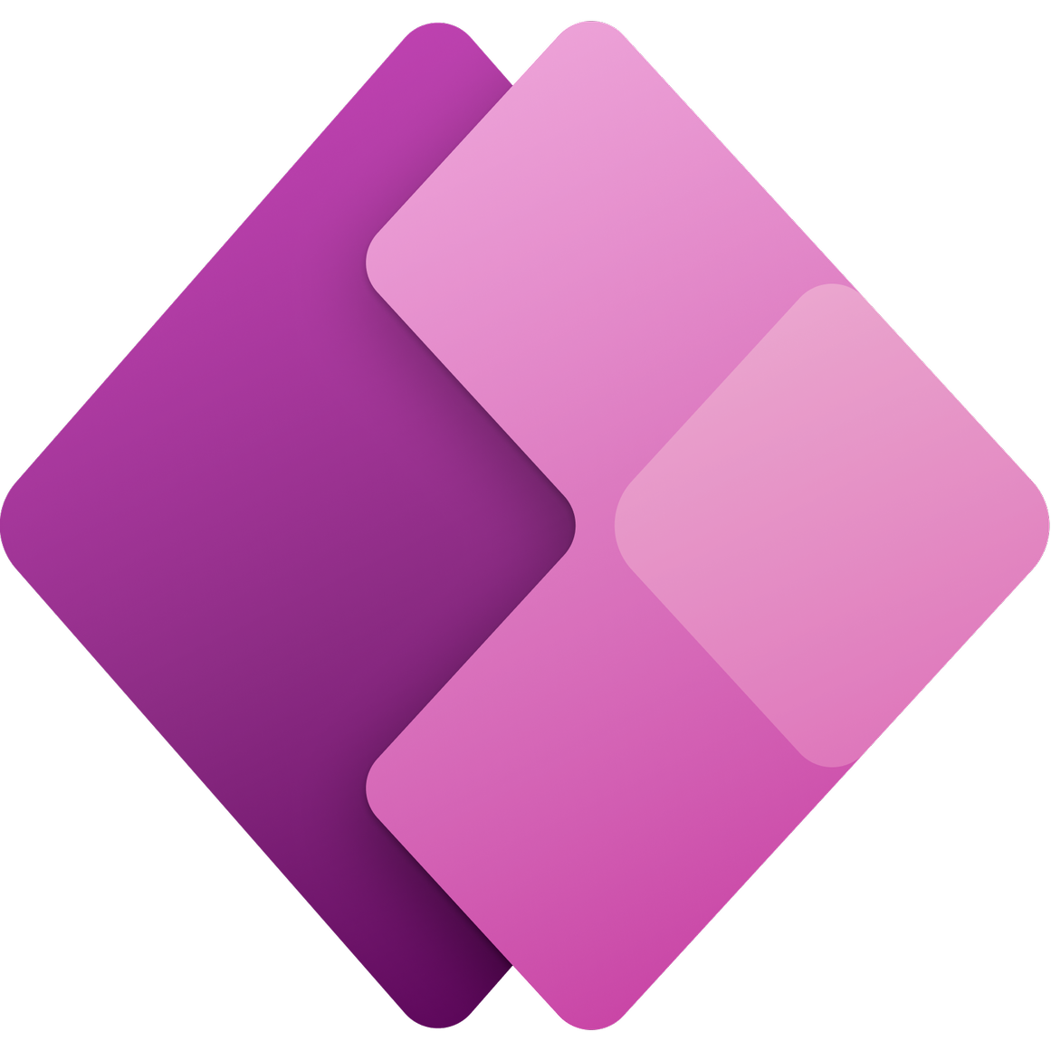





Microsoft Power Platform and Dynamics 365 Architecture
and more…
Apps
Sales
Service
Finance
Remote Assist
Microsoft Power Platform
Power Apps
Power Automate
Power Virtual Agents
Power BI
AI Builder
Microsoft Dataverse
Data Connectors
Management Tools

Slide 4
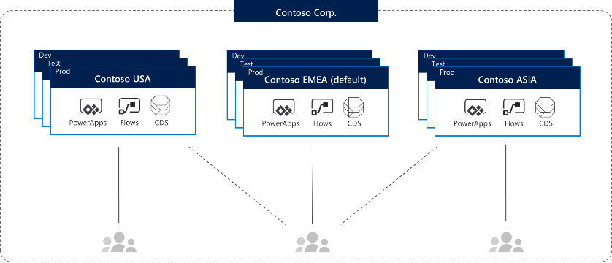
Environments
Azure AD Tenant
Environments
Notes:
Note: Screenshots will be updated to reflect branding changes later. Common Data Service is now Microsoft Dataverse.
Environments are containers that administrators can use to manage apps, flows, connections, and other assets; along with permissions to allow organization users to use the resources.
An environment lives within an Azure tenant, so authentication is through the Azure AD.
Environments are a scope for lifecycle and a scope for permission.

Slide 5
What’s in an environment and what’s not
In an environment
Not in an environment
Power Apps
Power Automate
Power Virtual Agent
Microsoft Dataverse
Custom Connectors
Power BI
Any Azure service deployed
Non-customer engagement Dynamics 365 apps (e.g. Finance)

Slide 6
Looking inside environments
Azure AD
Tenant
Microsoft Power Platform
Environment
Model Driven Power Apps
Entities
SharePoint
Power Apps
Process Flows
Teams
Power Automate
Exchange
Business Rules
Microsoft Dataverse
Excel
Security Model
Microsoft Azure
Azure AD
Data Gateway(s)
Logic Apps
Functions
Management API
Storage
On Premise Systems
On Premise Gateway(s)
Databases
Web API
SharePoint Data
File Storage
Notes:
There are no limitations to the number of apps or flows that can be deployed within an environment.
Default environment can also have a Microsoft Dataverse database.
Gateways, which leverage a common service that spans Microsoft Power platform (& includes Power BI)

Slide 7
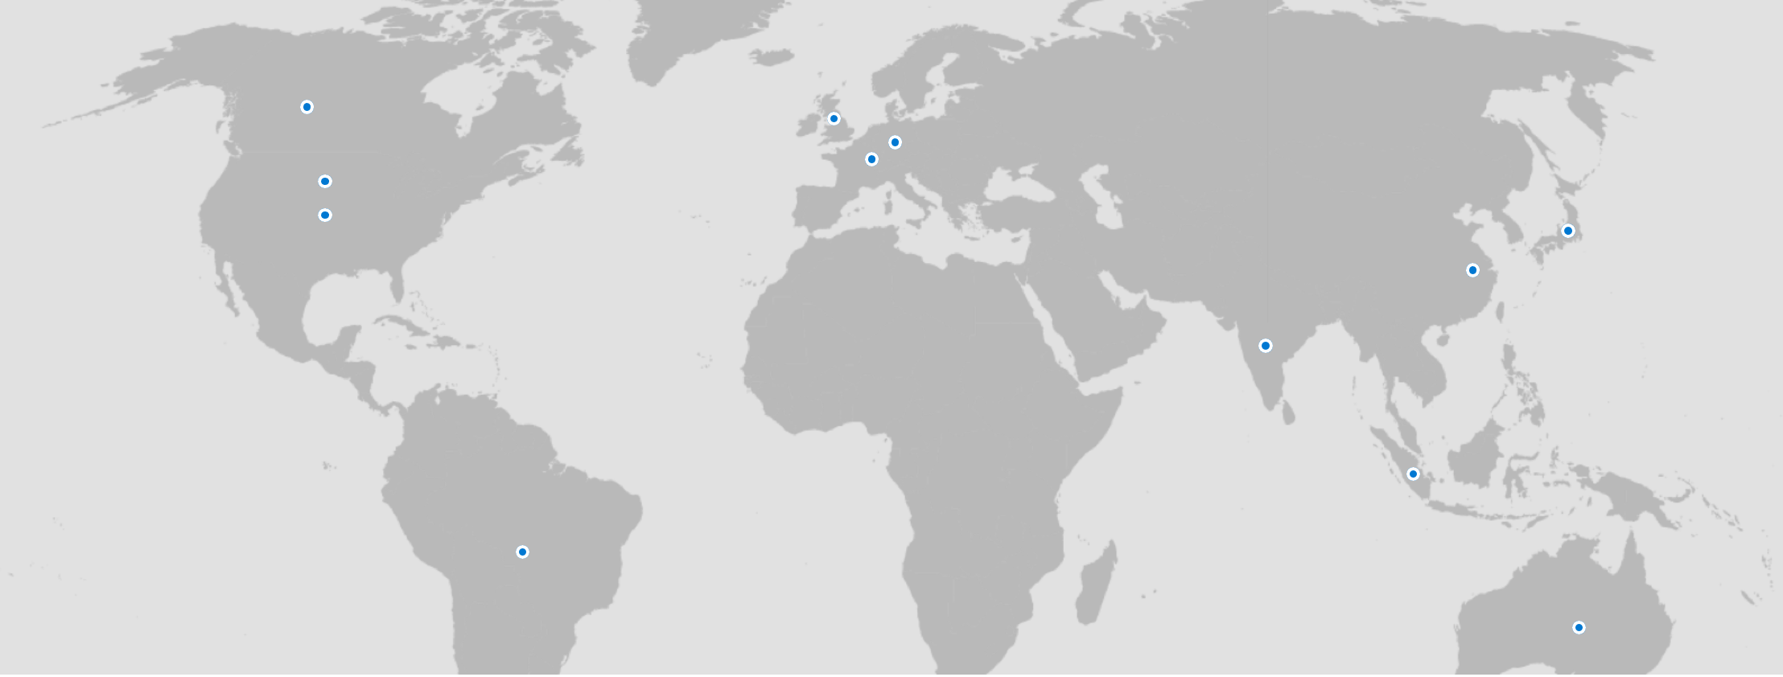
Microsoft Power Platform Environment/Data Location
Notes:
https://www.microsoft.com/en-us/TrustCenter/CloudServices/business-application-platform/data-location
In addition to the public locations there are also government specific regions only available to government use

Slide 8
When to use multiple environments
Handle application lifecycle management (ALM) – Dev / Test / Prod
To isolate resources that aren’t used by same users or share data
Allow conflicting customizations
Keep environments close to users that don’t share data
To isolate data that can’t be co-located
To provide places for makers to experiment
Notes:
Conflicting customizations
Global businesses with regional or country models that differ to account for variations in approach, market size, or compliance with legal and regulatory constraints
Organizations with different business areas / divisions, each with a different market, customers and/or model of operation.

Slide 9

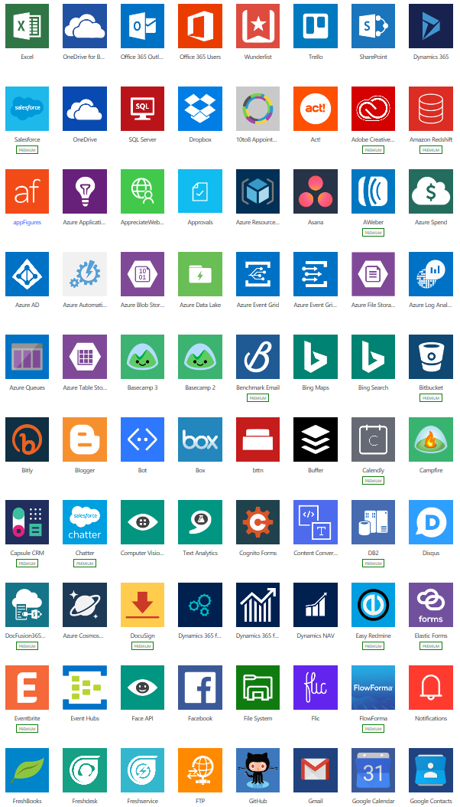
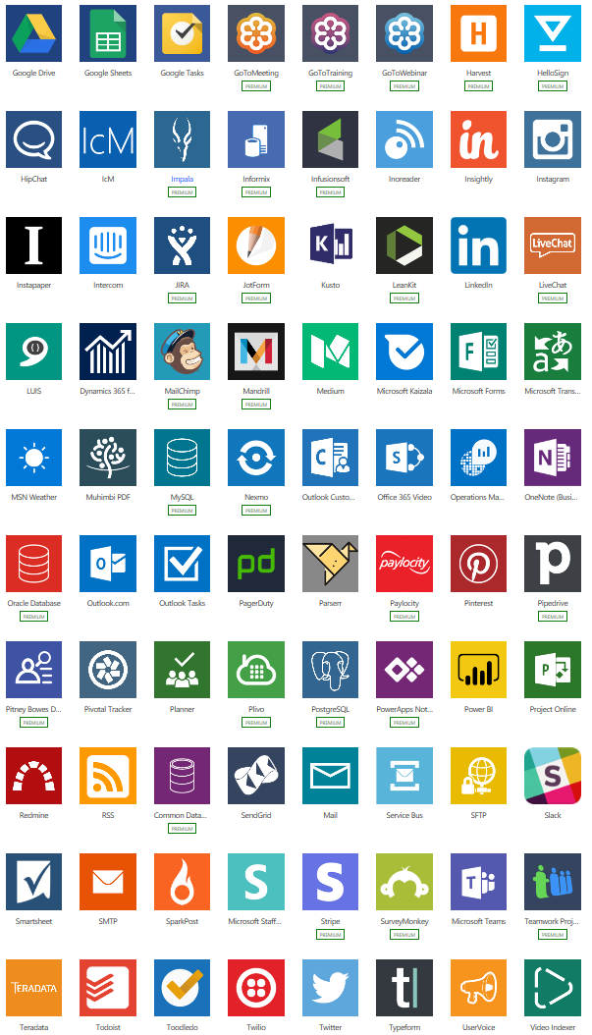
Working with data
Store data in the platform
Access data from the platform
Microsoft Dataverse
Data connectors

Slide 10
Connecting to Data
Leverage existing data sources and services
Built-in connectors to more than 300 systems and services
Create custom connectors as needed for internal and 3rd party REST services
Access data stored on-premises with the data gateway
Notes:
Connectors allow you to take advantage of the Microsoft Power Platform without moving your data. Power BI, PowerApps and Power Automate all leverage connectors allowing you to analyze, act and automate across data and services
Not all the public connectors support all the actions the underlying service supports, solution architects should investigate that the actions they require are supported otherwise a custom connector is required.

Slide 11
Custom Connectors
Import or create the Open API definition to describe existing API
Create a custom API to define your own actions
Actions can make it easy for consumers to invoke complex custom logic
Use Azure Functions or any REST API service to host
Supports OAuth (including Azure AD), API Key and basic auth
Can be packaged and deployed via solutions
Notes:
A lot of 3rd party services publish an Open API definition for their full API

Slide 12
Example – Register Student for class
Without a custom connector
With a custom connector/API
Check if student exists
Create student if not exist
Lookup class by course code
Check if class over capacity
Check if student has class pre-requisites
Create class student record
Notify user of results
“Student Details”
Input
Learning Service
Register Student
For Class Action
Output
“Student ID”
Notes:
Makers with out the custom connector would need to know the details of the service, by using a custom connector with an action this promotes good architectural design - loose coupling via a contract where the calling system doesn't need to know the details since they could change.

Slide 13
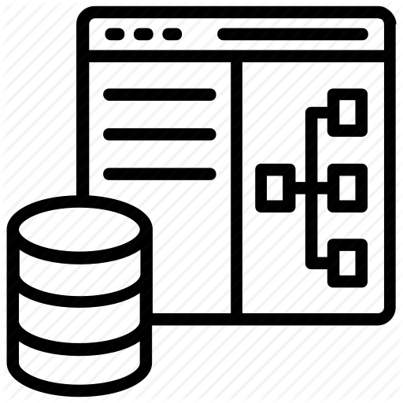
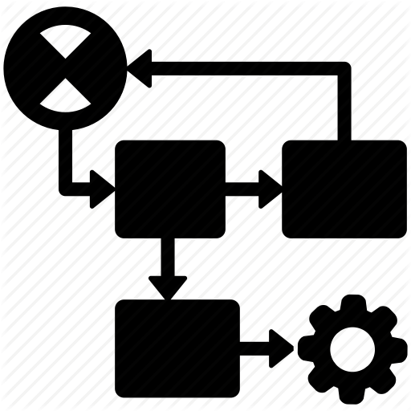

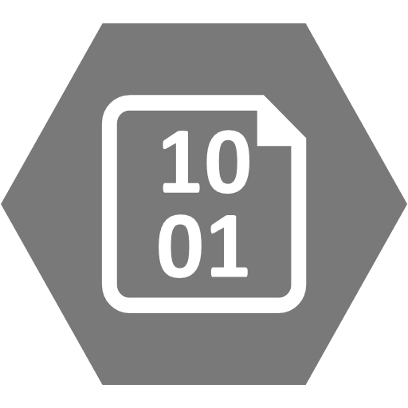


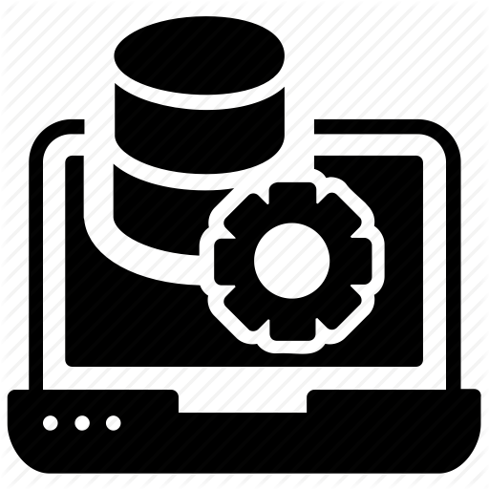




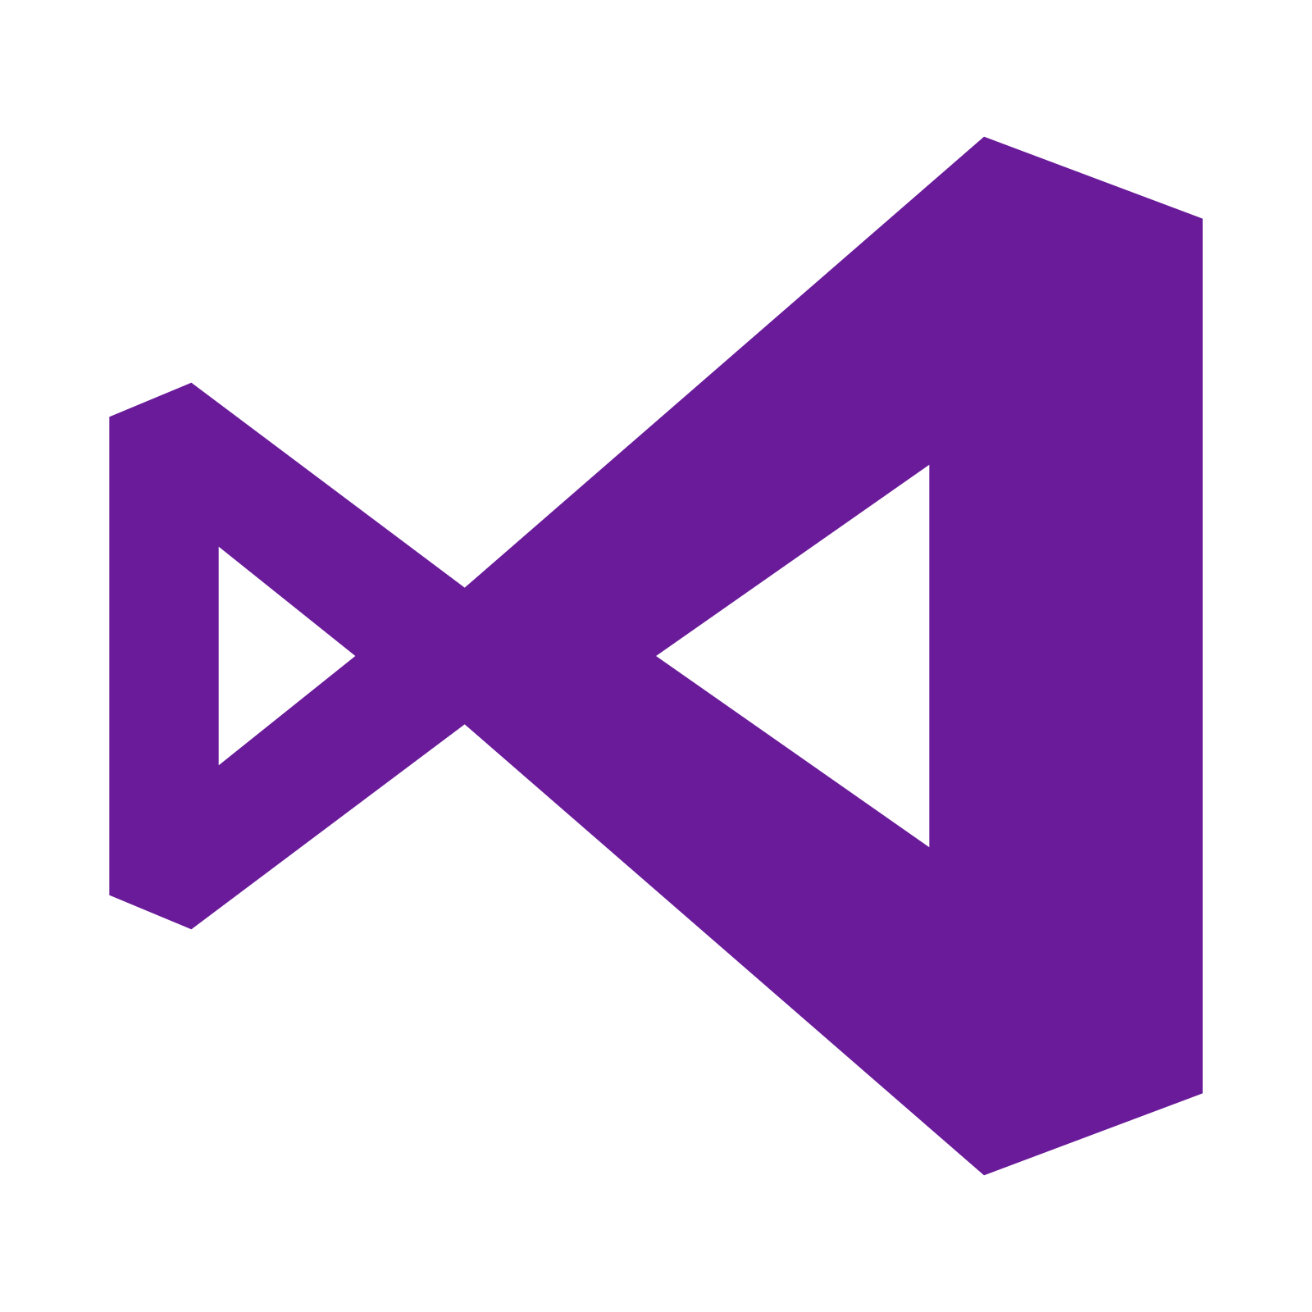





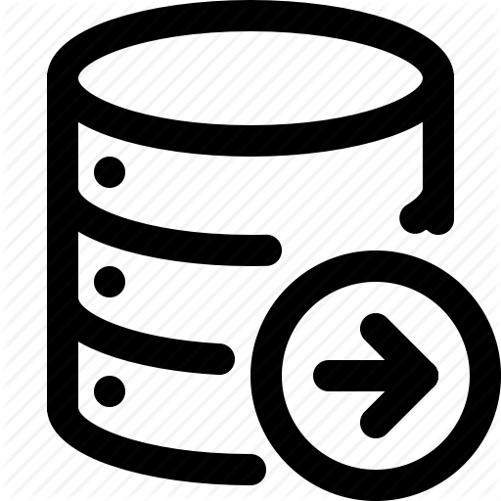


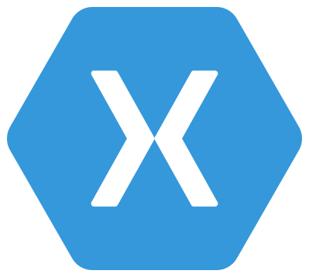

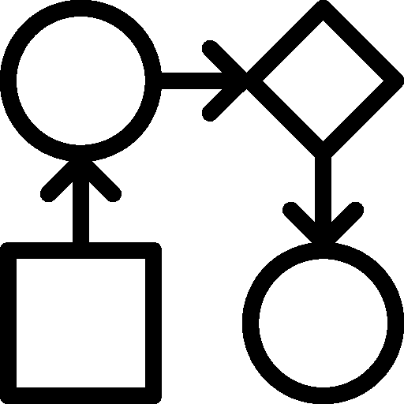
Microsoft Dataverse: What’s in the box?
Integration
Storage
Relational
databases
Eventing
Data
Catalog
and discovery
Files and
blobs
Logic
Log files
Webhooks
Jobs
Modelling
Security
Reporting
Semi-structured
data
Business
Rules
API
Calculated &
Rollup columns
Authentication
Duplicate
Detection
Data
validation
Search and
Find data
Authorization
Plugins
Data export
Common Data
Model
Auditing
Workflows
Data lake
Notes:
More than just a database
A configurable security model
Custom business logic executing regardless of application
Data stored in different ways depending on type (files vs data)
X Logo – Xamarin to represent building external customer facing applications

Slide 14
Microsoft Dataverse Data Stores
Database Capacity
Store and manage relational data
File Capacity
Store attachments, files, photos and videos
Log capacity
Record data changes over time for analysis & reporting purposes

Slide 15

Application API
Multi-tenant metadata driven APIs
Execution of named APIs made up of a sequence of dynamically discovered plugins
APIs can be modified with custom business logic via custom plugins by customer
Custom logic can be executed synchronous or asynchronous
OData
WS* (SOAP)
API Service
Event Pipeline
Validation Handlers
Transaction Start
Pre-Operation Handlers
Database Operation
Post-Operation Handlers
Transaction End
Async Handlers
Notes:
SOAP endpoint is deprecated and should not directly be used for new apps
App API is exposed to OData endpoint and SOAP endpoint(Deprecated)
When you are using the Common Data Service connector it is making calls to the Odata API

Slide 16
How should custom logic be performed?
Synchronous
Save Record
Users See Results
Operation 1
Operation 2
Operation 3
Asynchronous
Save Record
Users See Results
Operation 1
Operation 2
Operation 3
Notes:
Use this to have a discussion on async vs sync…

Slide 17
Where and when work gets done
Synchronous
Asynchronous
Blocks the user until completed
Can modify data before Microsoft Dataverse persists
Has minimal overhead to manage call
Limited to 2 minutes
Can run post operation or pre-operation
Included in original transaction
Does not block the user from seeing the results
Has extra overhead to track work
Can only run post operation
Modifications happen after operation so update call is required
Not part of the original transaction
Microsoft Dataverse – Plug-ins, Real time classic workflows
Microsoft Dataverse – Plug-ins, Power Automate flows

Slide 18
Where does custom logic run
Client
Server
Happens in the user interface, user sees result immediately
Only enforced in the app the logic is implemented in
Happens only when the data is sent to the server by the app, flow or API
User only sees results of custom logic in app on refresh of data
Enforced when any app, flow, or API is used
Canvas app formulas,
model-driven form script,
Microsoft Dataverse Business Rules,
Power Apps Component Framework
Microsoft Dataverse – Plug-ins, Power Automate flows, Microsoft Dataverse classic workflow, Microsoft Dataverse Business Rules

Slide 19
Platform limits
Not an infinite amount of resources
There are API request limits with allocations by license with the ability to purchase add-ons for increased usage
There are service protection limits, these can’t be increased
Design must not depend on infinite capacity
Notes:
https://docs.microsoft.com/en-us/powerapps/maker/common-data-service/api-limits-overview
Service Protection - To ensure consistent availability and performance for everyone the platform applies some limits to how APIs are used with Microsoft Dataverse. Service protection API limits help ensure that users running applications cannot interfere with each other based on resource constraints. The limits will not affect normal users of the platform

Slide 20
Release Processes
Rapid QFE / patch process to deploy in response to an issue or security risk (can deploy worldwide in hours).
Weekly patches to address bugs, performance issues, stability improvements, etc. It also includes new admin and customization features which you can opt into.
Twice annual release waves (in April and October) that include major features and end user impacting changes.
The release notes for these updates are published four months in advance, and you can test drive two months in advance
Image Bank
This document will contain ad source files and images to be used. Note: specific images have been designated for each campaign. In order to make each individual campaign as impactful as possible, please do not use images from other campaigns.

Slide 21
Wrapping up
Microsoft Power Platform and Dynamics 365 apps provide a flexible architecture that can be tailored to support many business scenarios
Staying up to date on the platform capabilities is essential to architecting solutions that will best leverage the capabilities

